Slide 1

SDformer: Transformer with Spectral Filter and Dynamic Attention for Multivariate Time Series Long-term Forecasting
Ziyu Zhou, Gengyu Lyu∗, Yiming Huang, Zihao Wang, Ziyu Jia and Zhen Yang
School of Computer Science, Beijing University of Technology, Beijing, China
Institute of Automation, Chinese Academy of Sciences, Beijing, China
IJCAI2024 (Main Track)
Notes:
Good afternoon, everyone. My name is Ziyu Zhou, and I am honored to be here today to present the paper titled 'SDformer: Transformer with Spectral Filter and Dynamic Attention for Multivariate Time Series Long-term Forecasting.' This paper was completed during my undergraduate studies at the School of Computer Science, Beijing University of Technology, under the guidance of Professor Gengyu Lyu.

Slide 2
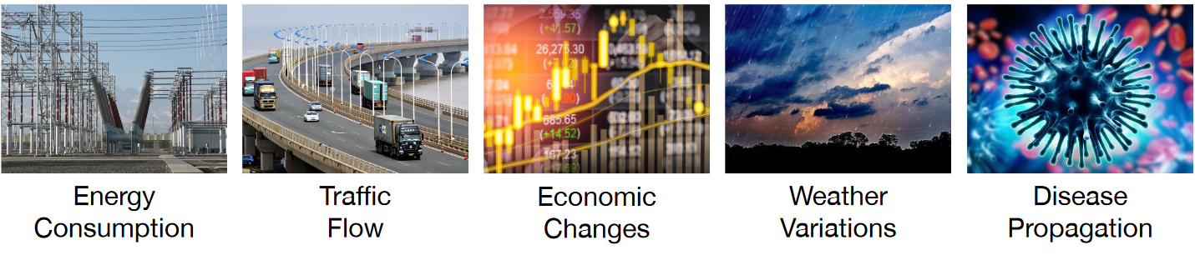
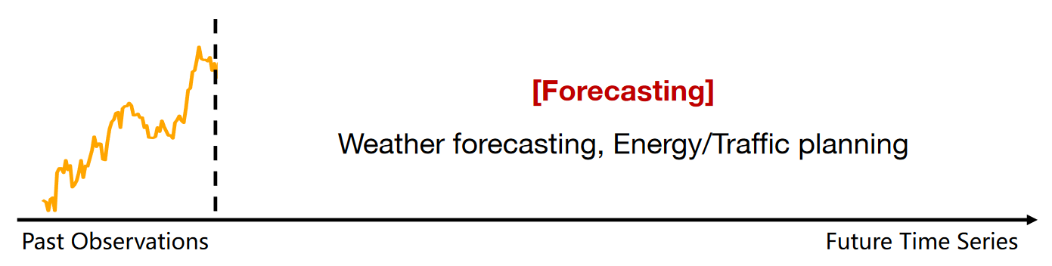
1 Introduction
Time series data is ubiquitous in human production and daily life.
With the rapid development of the Internet of Things and big data, a vast array of time series data has emerged.
Analyzing and utilizing this massive volume of temporal data has become an important issue in the field of data mining.
Long-term and accurate forecasting is of great significance for human production and daily life.
https://wuhaixu2016.github.io/pdf/ICLR2023_TimesNet.pdf
Notes:
Let's begin by addressing the first question: What is a time series? In simple terms, a time series is a sequence of data points collected through continuous observation of a system at a fixed sampling rate. Time series data are prevalent in various aspects of human daily life. For example, in the context of an electrical power system, the power load represents a time series that describes how the electricity consumption of a factory or residential area varies over time.For many downstream tasks in time series analysis, long-term forecasting holds significant importance for human production and everyday life. For instance, if we can accurately predict changes in traffic flow, we can make well-informed decisions about our travel plans.

Slide 3
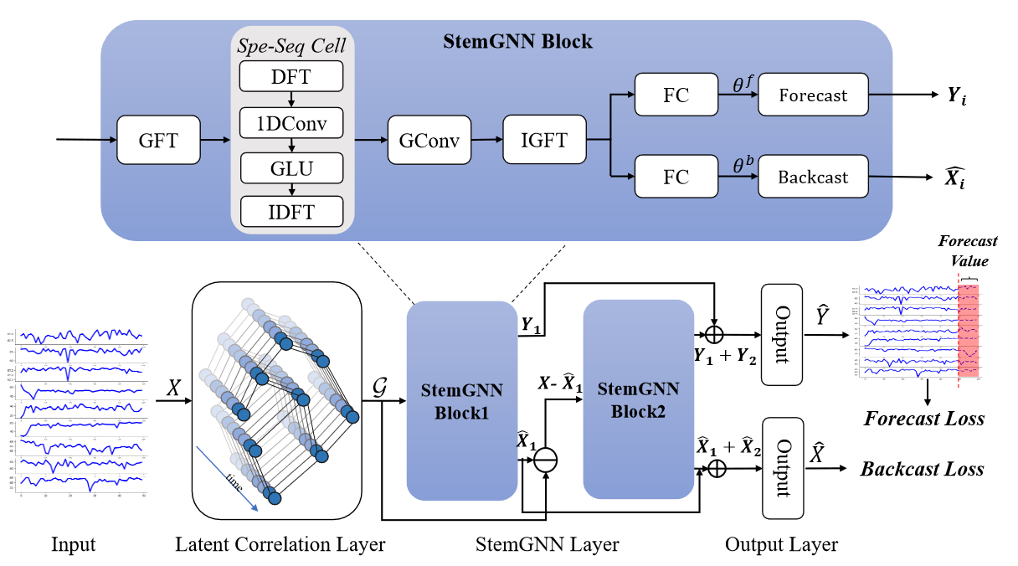
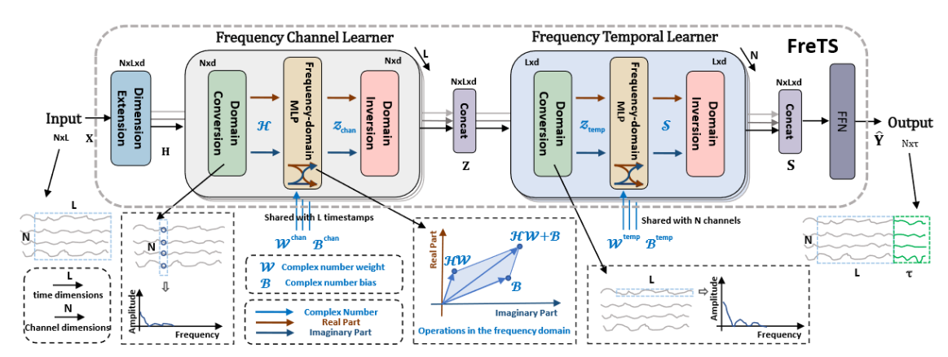
2 Related Work
Foundational Time Series Forecasting Models Based on Frequency Domain Methods
StemGNN
Frequency + GNN（NeurIPS 2020）
FreTS
Frequency + MLP（NeurIPS 2023）
Modeling time series in the frequency domain often involves integrating classical foundational models.
Notes:
The initial common approach to time series modeling involves integrating foundational models with frequency domain methods. We understand that the frequency domain is an alternative mapping of the time domain. Therefore, classic models combine frequency domain techniques with basic models, such as GNN and MLP to unearth features that are explicit in the frequency domain but implicit in the time domain.

Slide 4
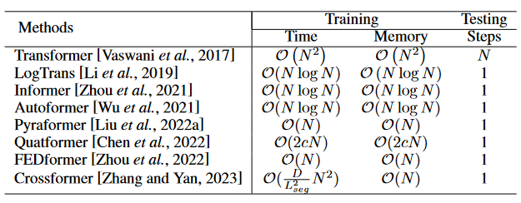
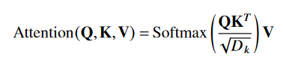
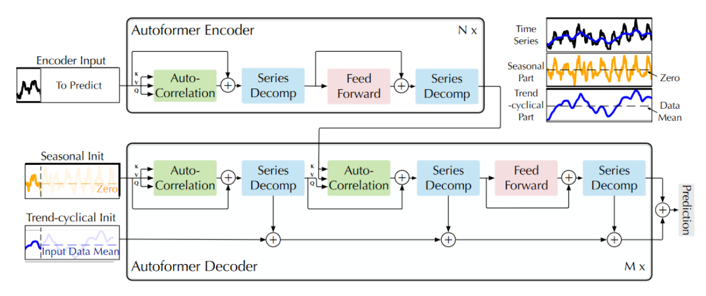
2 Related Work
Models Based on Innovative Attention Mechanisms Similar to Transformers
Autoformer
Auto-Correlation
O(NlogN)
（NeurIPS 2021）
Transformer-based models primarily need to address the issue of quadratic complexity.
Notes:
The second approach involves transformer-based forecasting models based on innovative attention mechanisms. The vanilla self-attention mechanisms are known for their quadratic complexity. To circumvent this, models akin to Transformers introduce novel attention mechanisms. For example, the AutoFormer model introduces an auto-correlation mechanism, reducing the quadratic complexity to logarithmic complexity. This significantly enhances the model's capability to handle long sequences.

Slide 5
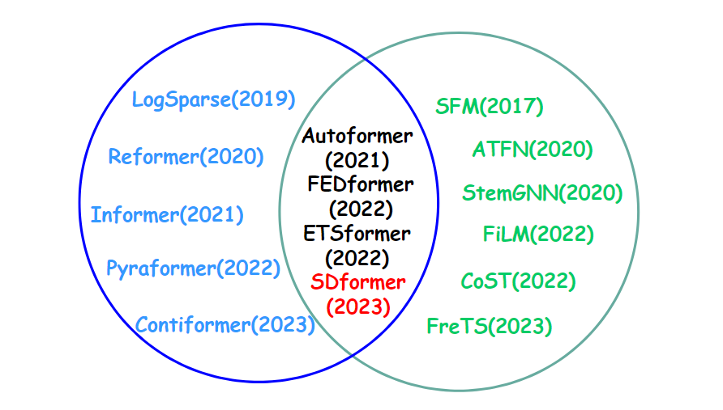
2 Related Work
Limitations of Existing Work
Attention failure
Innovative
attention
Frequency domain methods
Presence of noise
Attention map homogenization
Amplification of noise components
Unable to recognize variable correlations
Temporal features difficult to identify
Affects prediction outcomes
Affects prediction outcomes
Notes:
However, previous methods also exhibit certain shortcomings. For instance, with frequency domain approaches, earlier models failed to account for the noise in time series. When employing foundational models for modeling, this oversight can amplify the noise component, making it challenging to discern temporal features and ultimately affecting prediction outcomes. Regarding the innovative attention mechanism approach, earlier models overlooked the issue of attention failure, which is vividly demonstrated by the homogeneity in the rows of the attention map. This issue prevents the attention mechanism from recognizing relationships between variables, thereby adversely impacting the model's predictive accuracy.

Slide 6
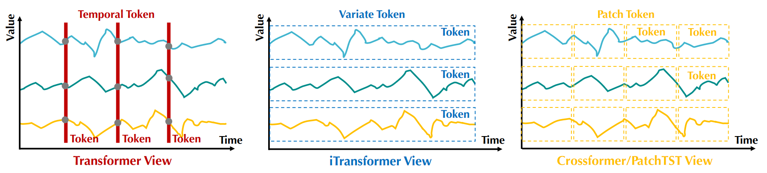
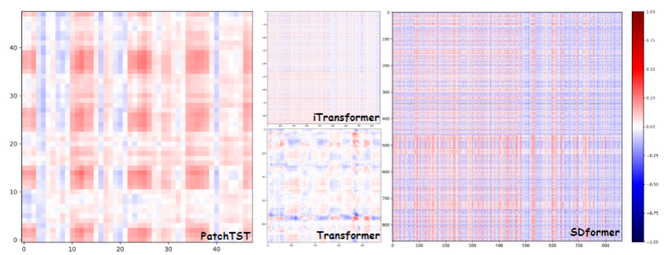
2 Related Work
https://arxiv.org/abs/2310.06625
Notes:
From this diagram, we can observe that the colors of the three attention maps on the left are very light, indicating that the distribution of attention scores is concentrated near zero within a very narrow range, and the distribution is smooth and uniform. Depending on the embedding method, the attention mechanism at this point fails to recognize the correlations between variables, patches, and time steps. This paper identifies this issue as the core research motivation and introduces the SDFormer, which effectively addresses this problem.

Slide 7
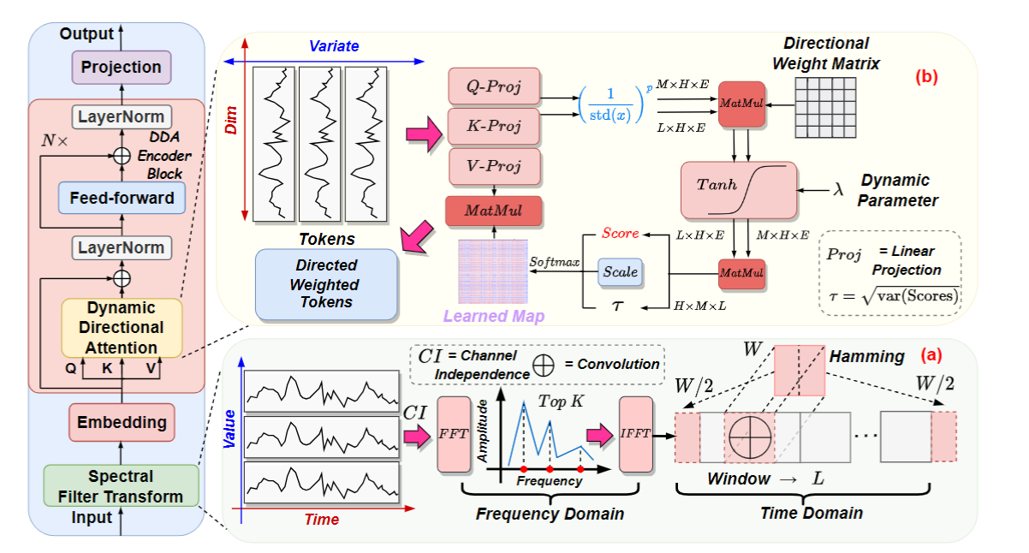
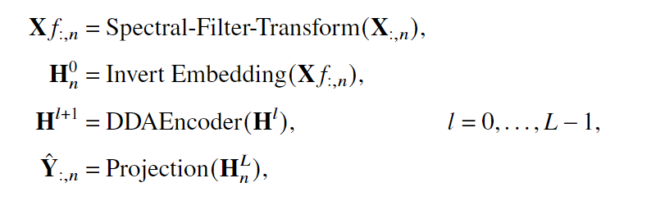
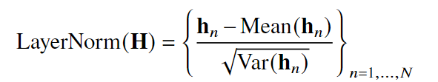
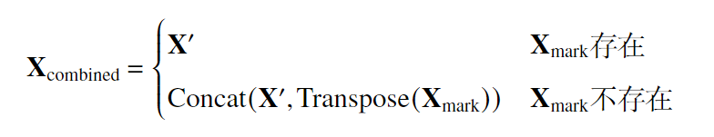
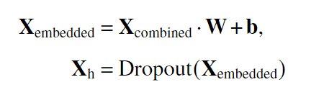
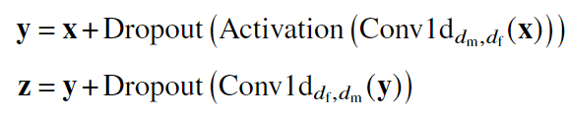
3 SDformer
研究背
景
LayerNorm
Embedding
FFN
Notes:
The SDFormer is specifically designed by referencing the encoder-decoder structure of the Transformer. The input is a fixed-length historical look-back window, and the output is the time series values to be predicted. Initially, the model's input passes through the Spectral Filter Transform for denoising and enhancing the smoothness of the sequence. This is followed by a reversal embedding layer, which embeds each variable of the multivariate time series into separate tokens. These tokens then enter into L stacked layers of DDA (Dynamic Directional Attention) encoders for deeper representation learning. The dynamic directional attention effectively identifies inter-variable associations. Layer normalization addresses the non-stationarity in the series and aids in model convergence, while the feedforward network facilitates learning representations along the time dimension. Finally, the representations obtained from the encoding are projected to the desired prediction length through a single-layer MLP.

Slide 8
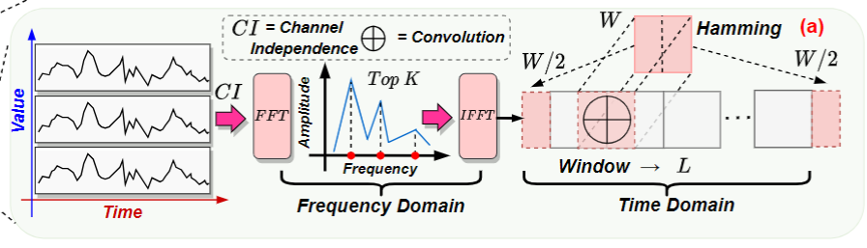
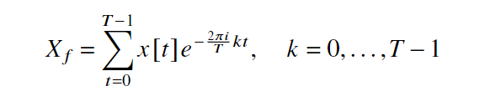
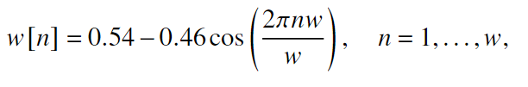
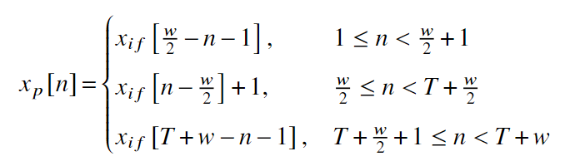
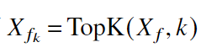
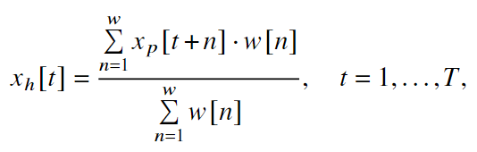
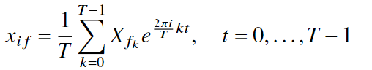
3 SDformer
Spectral Filter Transform
研究背
景
Frequency Domain
Time Domain
Notes:
The implementation of the Spectral Filter Transform (SFT) for multivariate time series involves processing each channel independently, without sharing weights across channels. Initially, the input data undergoes a Discrete Fourier Transform (DFT) to convert it into the frequency domain. In this domain, the frequencies corresponding to the top K amplitudes are retained. The data is then transformed back into the time domain. In the time domain, a window function is defined first. The first half and the last half of this window function are then used to pad the beginning and end of the sequence, respectively, in reverse order. Finally, this window function is utilized as a basis for convolution to perform one-dimensional convolution across the series.

Slide 9
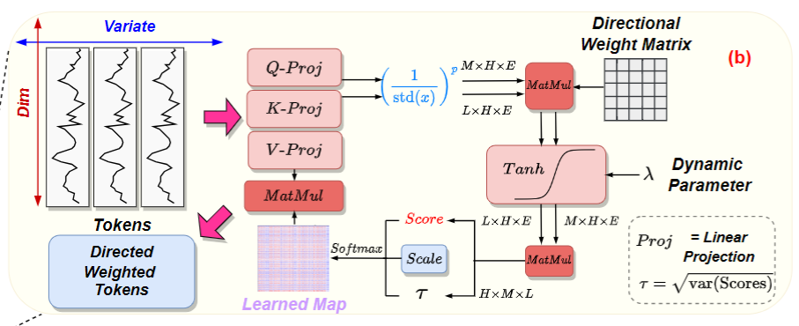
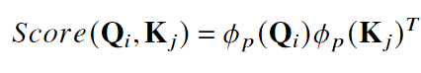
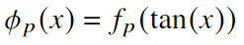
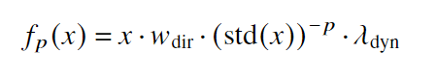
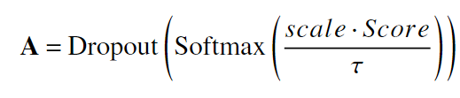
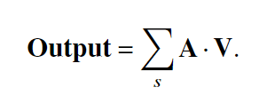
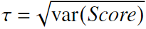
3 SDformer
Dynamic Directional Attention
研究背
景
Kernel Trick
Learnable parameters
Notes:
The Dynamic Directional Attention module presented is an enhanced version of the traditional self-attention mechanism. Its core principle involves applying a kernel function simultaneously to the query and key matrices. The pre-softmax attention score can be represented as the product of ϕp(Q) and the transpose of ϕp(K) where \(\phi\) is the kernel function. This function processes the input signal \(X\) by first taking its tangent and then passing it through a function fp. The fp is defined as the input signal divided by its standard deviation raised to the power of p, and then multiplied by two learnable parameters. The attention scores A in the Dynamic Directional Attention mechanism are calculated by taking the previously computed score, scaling it by a temperature coefficient, and then passing it through a softmax to obtain a probability distribution. To prevent model overfitting, some values are randomly dropped out using dropout. The final output of the module is obtained by performing a dot product of the attention score matrix with the value matrix.

Slide 10
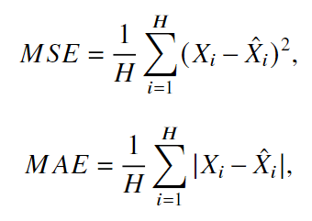
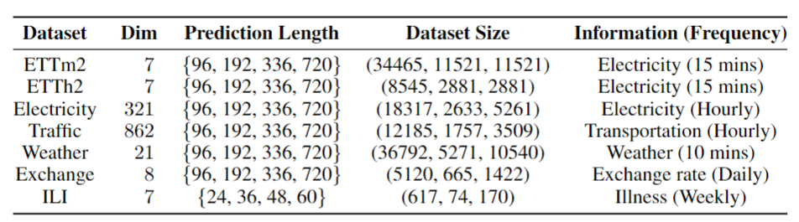
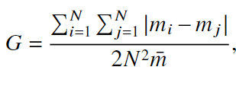
4 Experiments
Datasets
Baseline
Transformer: iTransformer(ICLR2024), PatchTST(ICLR2023), Crossformer(ICLR2O23), FEDformer(ICML2022), Non-Stationary Transformer(NeurIPS2022), Informer(AAAI2021), Autoformer(NeurIPS2021)
TCN:TimesNet(ICLR2023)
MLP:DLinear(AAAI2023), TiDE(arXiv23), LightTS(arXiv23)
Notes:
The experimental section of this paper selected seven publicly available real-world datasets to evaluate the effectiveness of the SDFormer in long-term forecasting experiments. It compares the SDFormer against eleven models recently published in top-tier academic conferences. The evaluation metrics used includeMSE and MAE to measure the accuracy of the predictions. Additionally, the Gini coefficient and the rank of matrices are introduced to assess the distribution of attention scores.

Slide 11
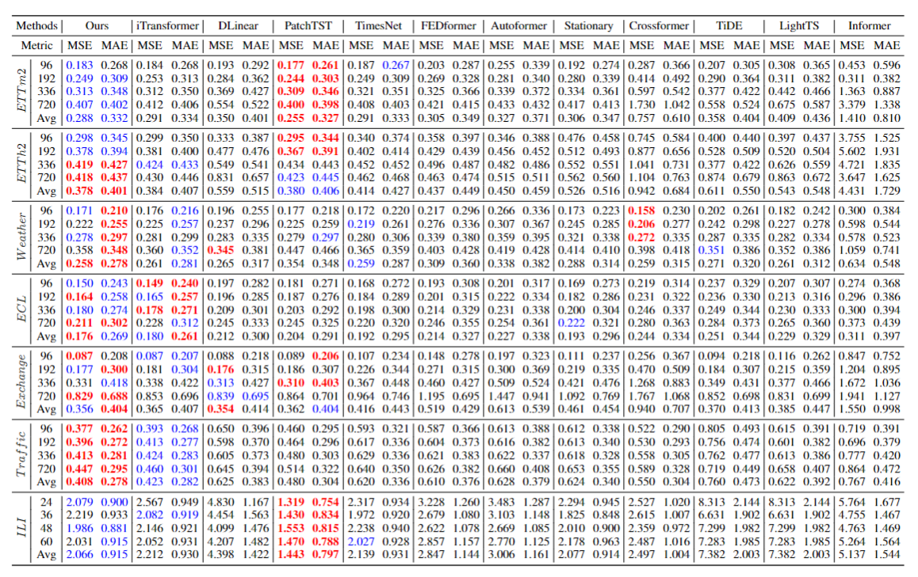
4 Experiments
Results（RED best，BLUE second best）
12 × 7 × 4 = 336 settings
研究背
景
Notes:
In the long-term forecasting experiments of this paper, the input length for the time series is set at 96, with output lengths of 96, 192, 336, and 720. It is observed that the SDFormer SOTA results in five out of seven datasets, underscoring its superior predictive capabilities across multiple forecasting horizons.

Slide 12
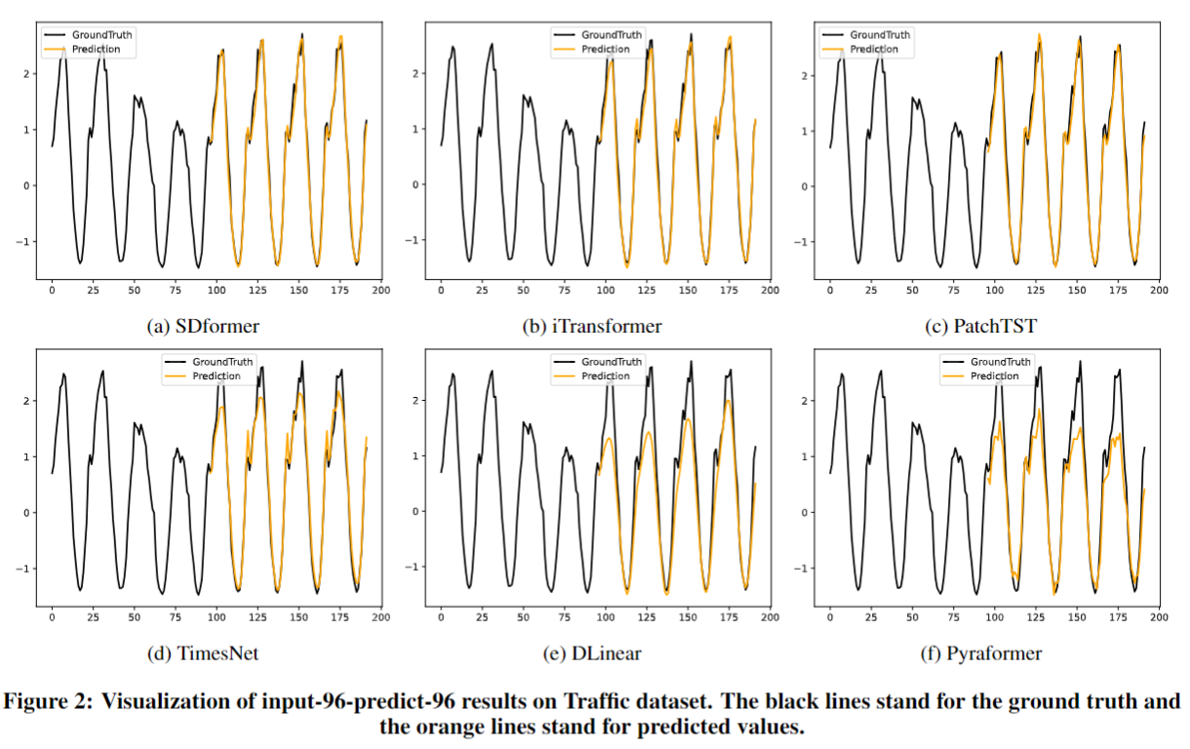
4 Experiments
Visualization（Traffic）
研究背
景
Notes:
From the visualization of the prediction results, it is evident that the SDFormer delivers exceptionally good performance in forecasting time series. The results demonstrate the model's accuracy and effectiveness in capturing the underlying patterns and trends of the data.

Slide 13
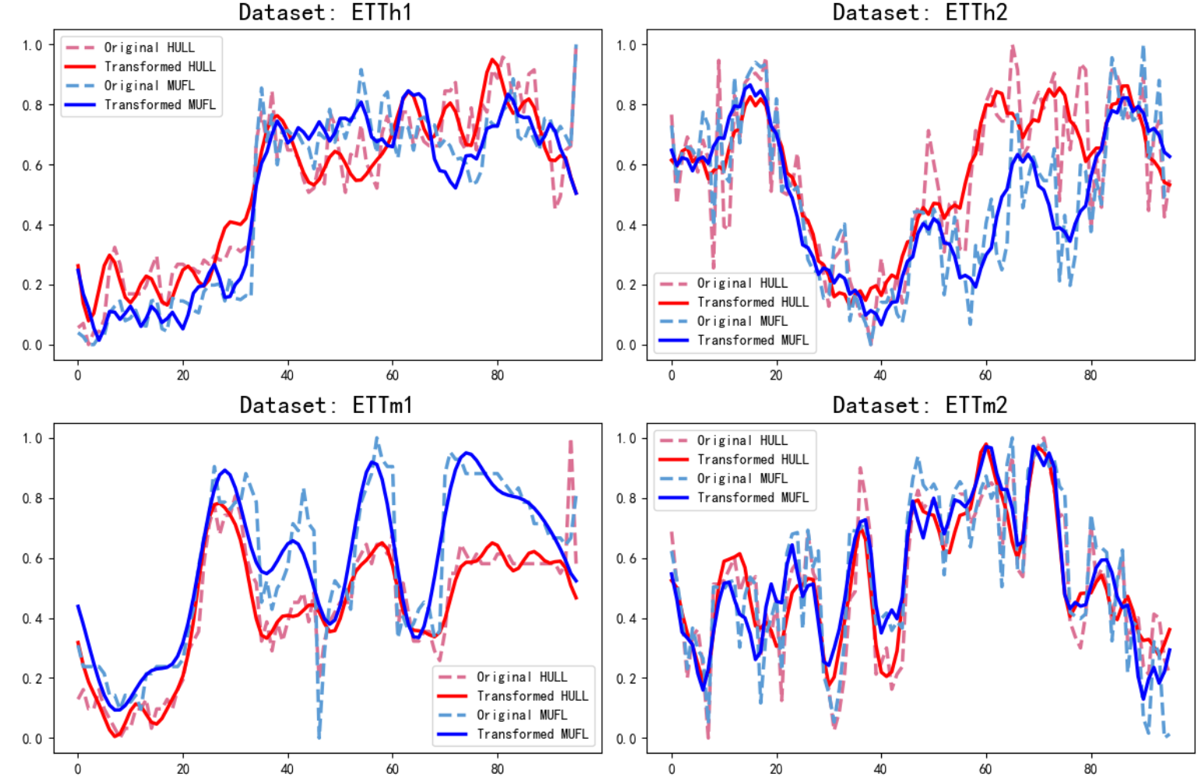
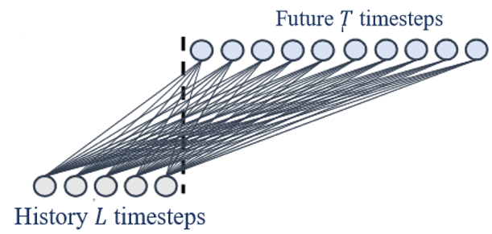
4 Experiments
Spectral Filter Transform
研究背
景
Single Layer MLP
Macro Patterns
Notes:
The Spectral Filter Transform is designed to denoise and smooth time series data. As seen in the chart, the red and blue solid lines represent the sequences post-application of this module, while the corresponding dotted lines depict the sequences prior to its application. The Spectral Filter Transform effectively reduces complex fluctuations in the data, enabling the effective extraction of macro trends such as continuity and periodicity. The conceptual design of this module is analogous to the effects of a single-layer Multilayer Perceptron (MLP) in time series modeling, applying similar principles to enhance data interpretability and trend analysis.

Slide 14
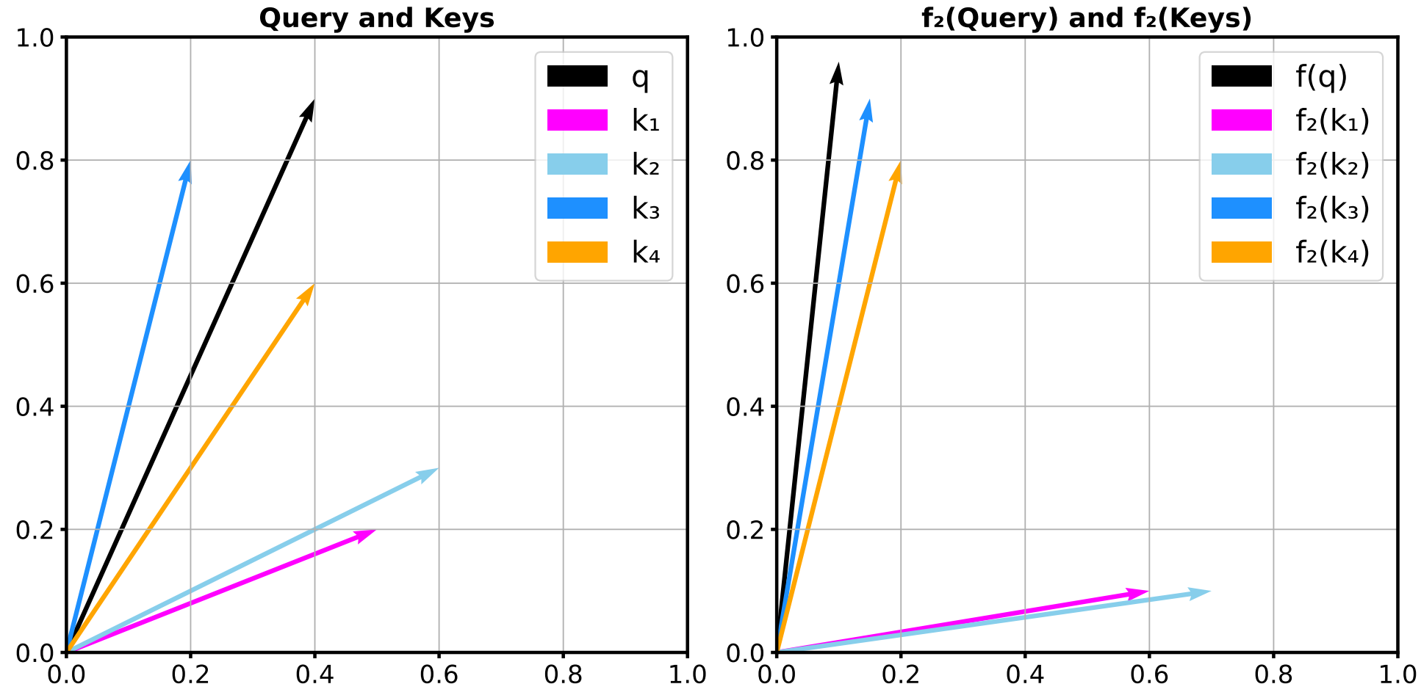
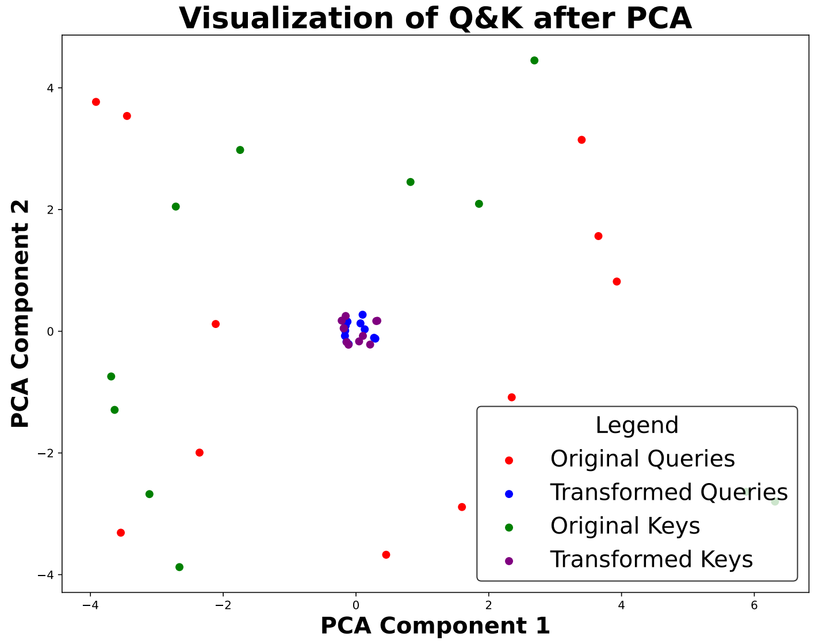
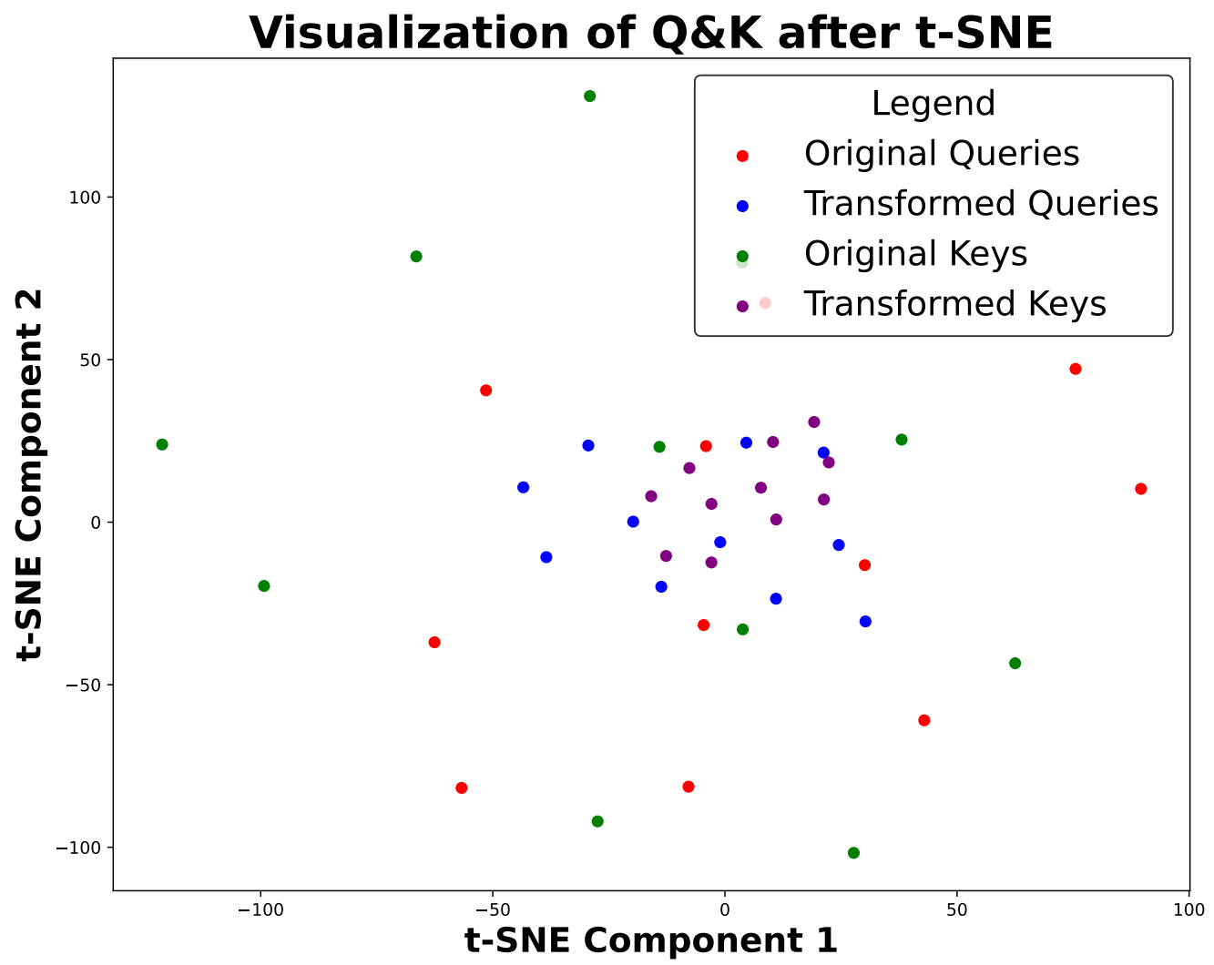
4 Experiments
Dynamic Directional Attention
Notes:
Regarding the dynamic directional attention mechanism, we understand that within an attention framework, a single query corresponds to multiple keys. The effect of the function is to move both the query and the keys towards a closer coordinate axis. This process enhances the similarity of similar q-k pairs while also accentuating the dissimilarity of dissimilar pairs. Experiments show that after the application of this function, the distribution of queries and keys becomes denser than before. As a result, this leads to a more distinctive and pronounced distribution of attention scores, enabling clearer differentiation and more effective focus within the model.

Slide 15
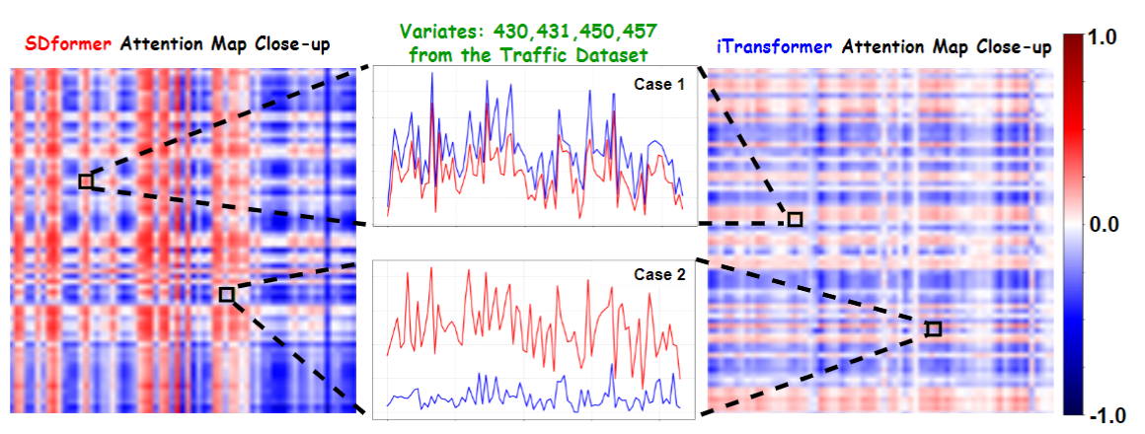
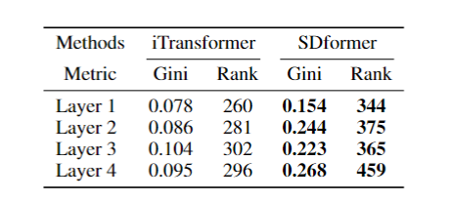
4 Experiments
Notes:
Furthermore, the paper includes a case study to demonstrate the SDFormer's resolution of the attention failure issue. In Case 1, two time variables exhibit a high degree of similarity, yet they receive low attention scores in traditional self-attention mechanisms, as indicated by the very light colors in the attention map. However, in the SDFormer, similar variables receive higher attention scores, and the local colors on the attention map are darker. This indicates that the SDFormer can effectively model the interrelationships among multivariate time series variables by recognizing their similarities. The paper substantiates the effective resolution of the attention failure problem through both qualitative and quantitative analyses.

Slide 16
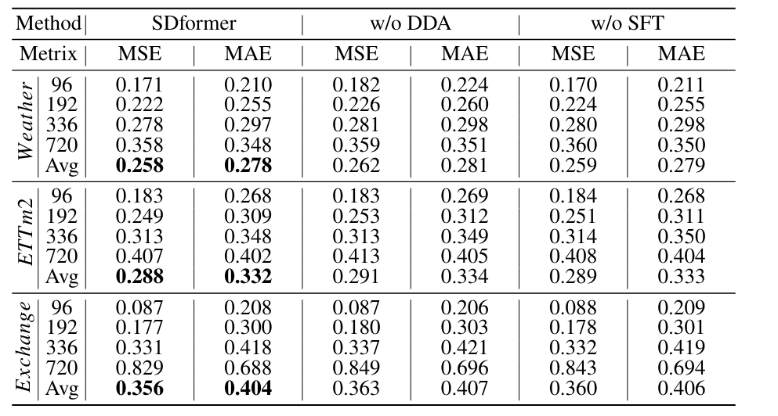
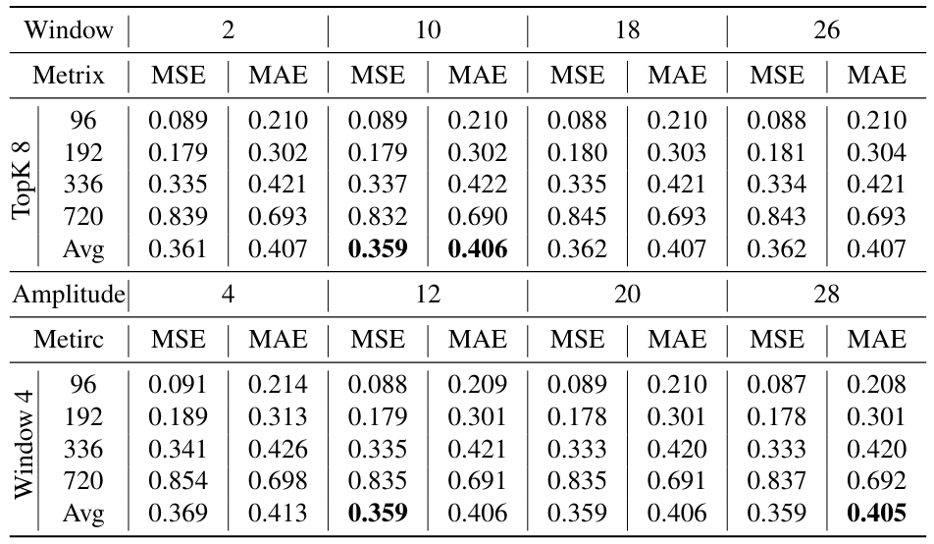
4 Experiments
w/o SFT: Does not eliminate the impact of noise on the model's ability to recognize temporal features.
w/o DDA: Self-attention mechanisms cannot effectively identify variable correlations.
SDformer: Addresses both of the above issues, achieving optimal results.
Window size: Ensures effective smoothing without destroying the original characteristics of the sequence.
Amplitude: Retaining more frequency components in long-term forecasting is crucial for capturing complex temporal dynamics.
Notes:
Additionally, this paper conducts ablation experiments on the complete SDFormer. The removal of the SFT or substituting the DDA with the vanilla self-attention mechanism both result in deteriorated model performance, demonstrating the effectiveness of the modular design in SDFormer. Moreover, the paper also performs a sensitivity analysis of hyperparameters, revealing that the model's performance is not overly sensitive to variations in hyperparameters, which underscores its robustness.

Slide 17
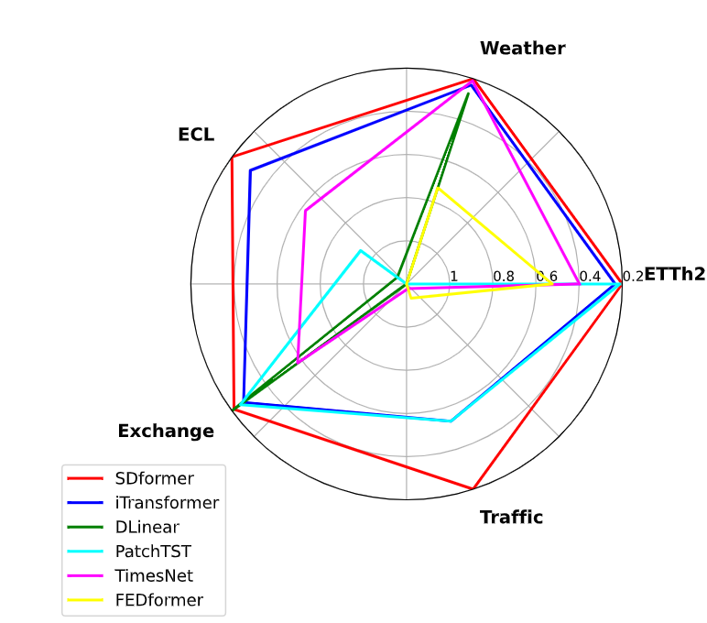
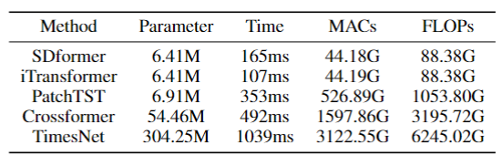
4 Experiments
Notes:
The radar chart clearly demonstrates that the SDformer achieves optimal results across multiple datasets. Simultaneously, it surpasses most state-of-the-art (SOTA) models in terms of the number of parameters and training speed. It can be said that the SDFormer balances exceptional performance with relatively low computational complexity.

Slide 18
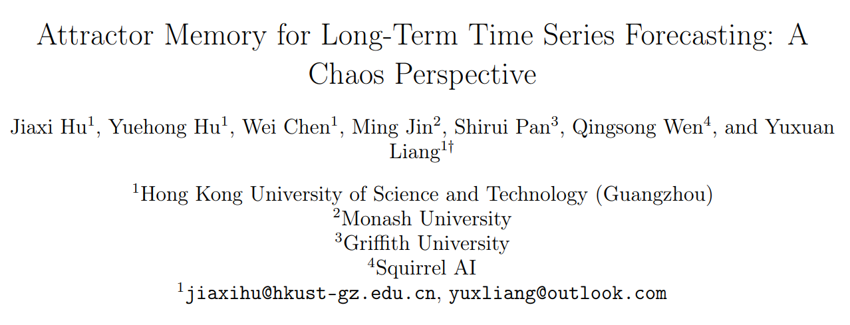

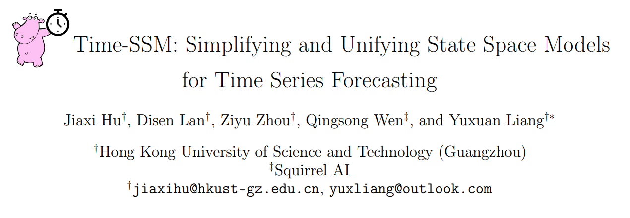
* Beyond Transformers
Arxiv 2402.11463
CityMind Lab
HKUST(GZ)
Arxiv 2405.16312
Notes:
Besides Transformers, we believe there are many other ways to model time series, such as the two papers from our group: Attraos and Time-SSM. Both papers seek to transcend traditional discrete modeling by leveraging concepts from continuous dynamics and chaos theory, aiming to more accurately represent and predict complex time series data. We think that viewing time series through the lens of dynamical systems can lead to more effective modeling. We welcome everyone to continue following the future work of our CityMind Lab.

Slide 19


Thanks!
Wechat
Profile

